Slide 1
LabVIEW Report 28/01/2021
P. Hacker

Slide 2
Reviewed LabVIEW DAQ routine
reviewed the LabVIEW DAQ routine to minimize lag, calculation overhead and optimize comfort of use for simplicity
started from ‘original’ master branch that included all changes from frequency selection, power calculation, register settings and real time feedback
build two new DAQ programs that include a number of changes:
removed all disable and if structures that were originally used for debugging
only manual acquisition time input
two trigger settings: start of VI time, CODAC last trigger
timing inputs to [s], time display as needed in [s, ms, ns]
samples to exclude from acquisition fix to 1000, included in start/time calculation of acquisition itself
DAC range settings now only either global or individual via file input (10-80mV)

Slide 3
Reviewed LabVIEW DAQ routine
reviewed the LabVIEW DAQ routine to minimize lag, calculation overhead and optimize comfort of use for simplicity
started from ‘original’ master branch that included all changes from frequency selection, power calculation, register settings and real time feedback
build two new DAQ programs that include a number of changes:
calibration values for integrity check can be calculated from current measurement or either input for lab tests via file (provided one with OP1.2b 95% quantile)
calibration values now in [A^2, Ohm, s]
raw signal display (only, no adjusted or power per channel) in [mV]
offset measurement for integrity check, display in [mV]
reduced archive upload, only necessary data

Slide 4
Reviewed LabVIEW DAQ routine
reviewed the LabVIEW DAQ routine to minimize lag, calculation overhead and optimize comfort of use for simplicity
started from ‘original’ master branch that included all changes from frequency selection, power calculation, register settings and real time feedback
build two new DAQ programs that include a number of changes:
new timing settings: assuming that there is an intrinsic timing error from internal measurement, i.e. inside DAQ loop, of ~0.04ms
HEX DECIMAL FREQ [Hz] T [ms]
===================================================
x4F 79 1318 0.7584
x63 99 1052 0.9504
xA2 162 643.0 1.5552
x148 328 317.6 3.1488
x294 660 157.8 6.336

Slide 5
Reviewed LabVIEW DAQ routine
Raw_wRTF
real time feedback plot with full P_rad of both camera arrays and single channel/fast P_rad
geometry input via file
power calculation now only via FIFO, no Savitzky Golay
Raw_w/oRTF
removed voltage out, power calculation, P_rad routine, geometry input entirely

Slide 6
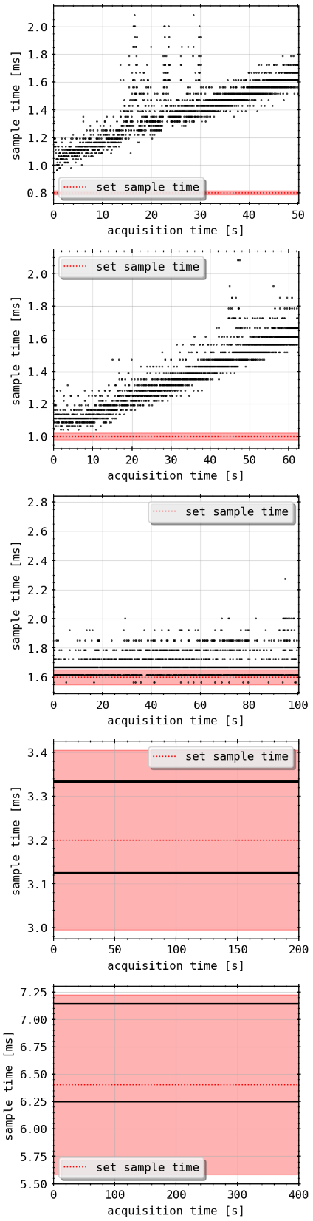
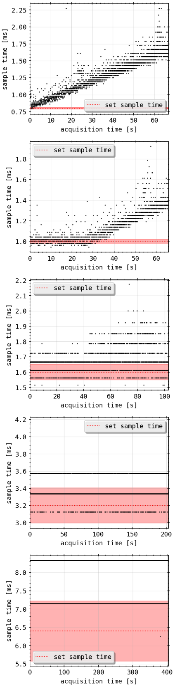
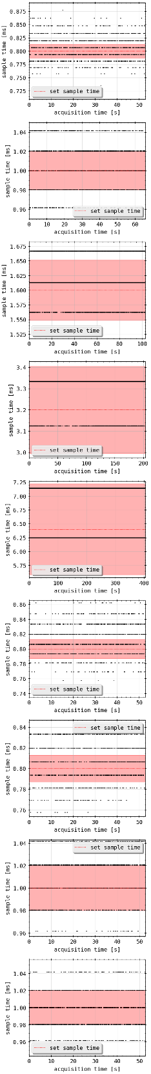
Reviewed LabVIEW DAQ routine: Performance
master
Raw_wRTF
Raw_w/oRTF
0.8ms

Slide 7
Reviewed LabVIEW DAQ routine: Performance
master
Raw_wRTF
Raw_w/oRTF
1.0ms

Slide 8
Reviewed LabVIEW DAQ routine: Performance
master
Raw_wRTF
Raw_w/oRTF
1.6ms

Slide 9
Reviewed LabVIEW DAQ routine: Performance
master
Raw_wRTF
Raw_w/oRTF
3.2ms

Slide 10
Reviewed LabVIEW DAQ routine: Performance
master
Raw_wRTF
Raw_w/oRTF
6.4ms

Slide 11
Reviewed LabVIEW DAQ routine: Performance
raw_woRTF
unloaded
loaded
0.8ms

Slide 12
Reviewed LabVIEW DAQ routine: Performance
raw_woRTF
unloaded
loaded
1.0ms

Slide 13
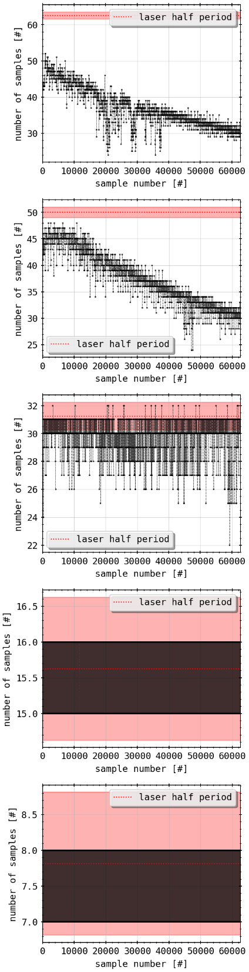
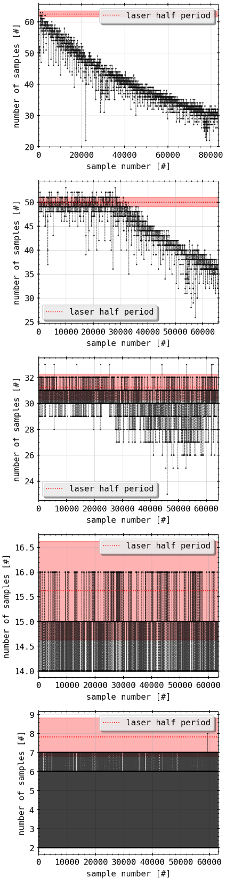
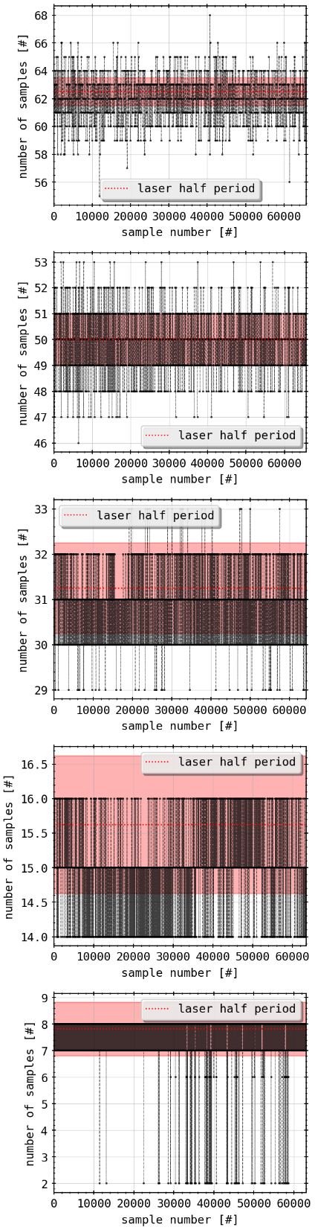
Reviewed LabVIEW DAQ routine: Performance
samples per laser half period
master
Raw_wRTF
Raw_w/oRTF
0.8ms

Slide 14
Reviewed LabVIEW DAQ routine: Performance
samples per laser half period
master
Raw_wRTF
Raw_w/oRTF
1.0ms

Slide 15
Reviewed LabVIEW DAQ routine: Performance
samples per laser half period
master
Raw_wRTF
Raw_w/oRTF
1.6ms

Slide 16
Reviewed LabVIEW DAQ routine: Performance
samples per laser half period
master
Raw_wRTF
Raw_w/oRTF
3.2ms

Slide 17
Reviewed LabVIEW DAQ routine: Performance
samples per laser half period
master
Raw_wRTF
Raw_w/oRTF
6.4ms

Slide 18
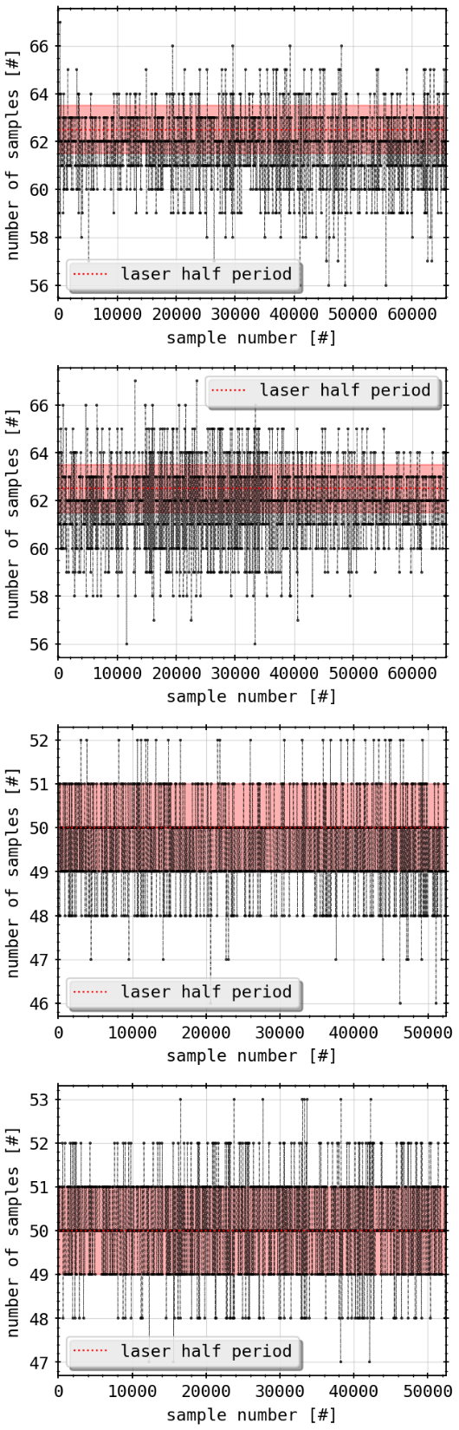
Reviewed LabVIEW DAQ routine: Performance
raw_woRTF
unloaded
loaded
0.8ms

Slide 19
Reviewed LabVIEW DAQ routine: Performance
raw_woRTF
unloaded
loaded
1.0ms

Slide 20
Git-Lab and Changelog.md
https://git.ipp-hgw.mpg.de/pih/LabVIEW_QSB holds all relevant changes and versions under branches, i.e. master, raw_wRTF and raw_w/oRTF
Changelog.md includes all information about the VI I was able to acquire and learn throughout the optimization process
versions as of today (02/05/2020) also located in QSB_Bolometry E5 backup server

